Slide 1
Markdown-based Semantic Annotation of Workflow Scripts
Xiaoliang Jiang

Slide 2
Introduction
Problems
Today, we can generate RDF outputs with correct embedded workflow semantics.
But the user must be an expert in semantic workflow to generate or understand it.
User may not finish their work in a single terminal.

Slide 3
Introduction
Possible solutions
R extension for R users.
Minimize the embedded inputs which users should type in.
Automatically or Semi-automatically generating RDF outputs.
Explain the outputs in different ways.

Slide 4
Method
Based on “strcode” to add semantic branch.
Use Shiny to build a UI.
Minimized the inputs for users.
Multiple outputs options (Turtle RDF file or RDF diagram).

Slide 5
An example for embedding semantic breaks

Slide 6
An example for generating RDF diagram

Slide 7
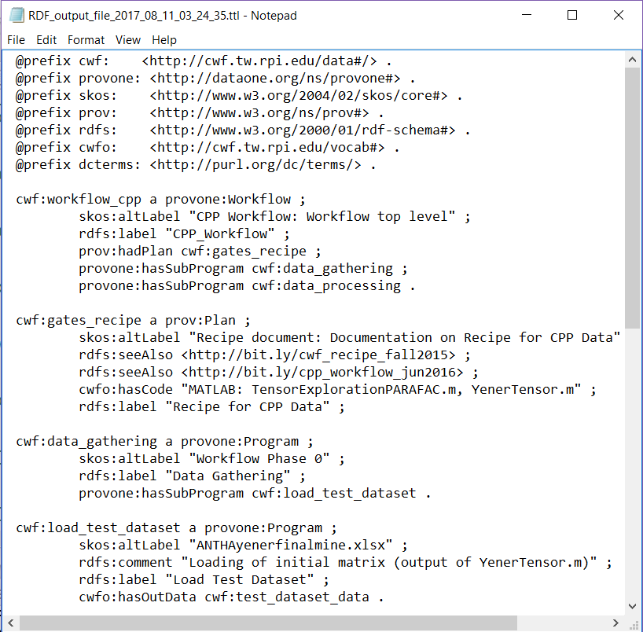
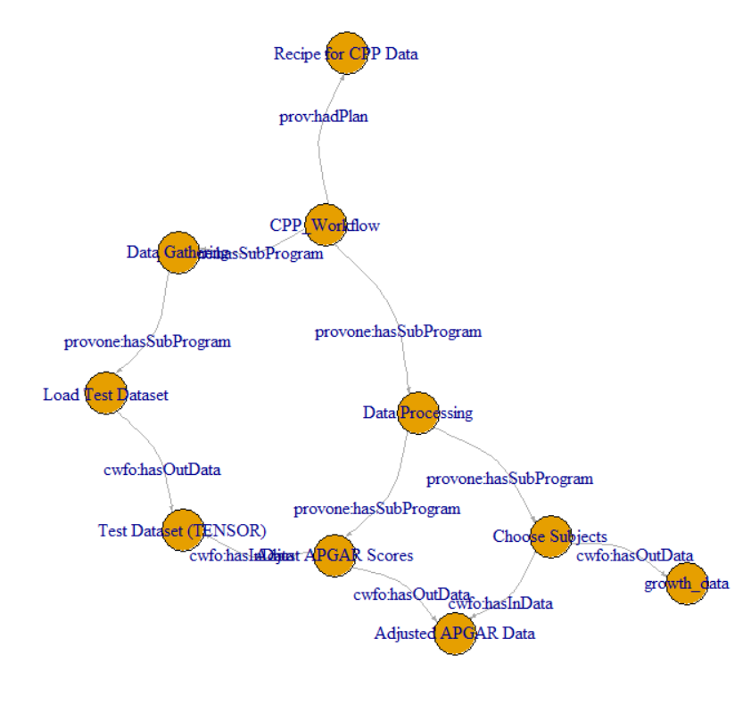
Another “toy” example for a real workflow
Graph 1. A .ttl RDF file
Graph 2. A RDF graph generate by igraph

Slide 8
Benefits
Support scientific domains.
Enhance insight.
Enhance reproducibility & rigor.
Demonstrate new capabilities for leveraging and reusing data analytics workflows on future problems.

Slide 9
Future Work
Further testing by data scientists using a variety of domain use cases.
Enhance stability for the functions.
Compare it with other existing tools, like YesWorkflow (YW).
Attempt to build a connection with existing tools, like generating YW scripts.

Slide 10

Thanks
Any questions?
To install:

